Slide 1
ECORC Sample PowerPoint using font size 54 for title slide

Slide 2
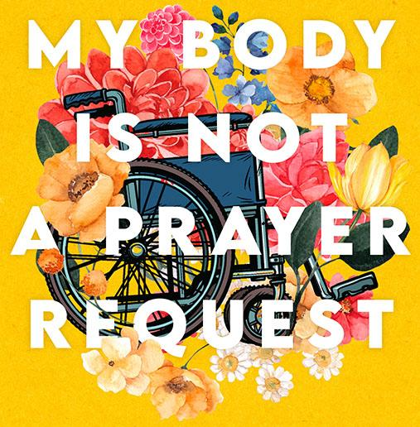
Disability Justice in the Church
By Amy Kenny
using font size 44

Slide 3
“Have you ever heard them used in a positive way? Has ‘lame’ ever meant anything good? Have you ever experienced ‘crippled’ as something powerful? Disability metaphors allow everyone to agree that my body is bad.” (page 93) **FONT SIZE 48**

