Slide 1
East Central Ontario Regional Council Support Team
Rev. Darren Liepold: dliepold@united-church.ca
Rev. Éric Hébert-Daly: ehebertdaly@united-church.ca

Slide 2


Growth and Renewal Toolkit

Slide 3
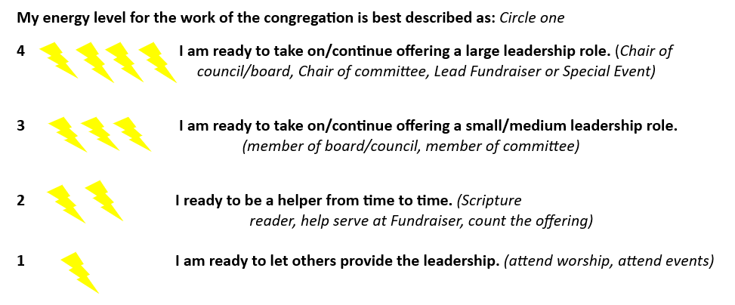
Congregational Vitality Snapshot
(Energy Audit)

Slide 4
Deep, Bold, Daring Exercise
How do you embody Deep Spirituality?
  Examples: worship, pastoral care, supporting self-care
How do you embody Bold Discipleship?
  Examples: faith formation and Christian education, leadership development, stewarding resources, connecting to the wider church
How do you embody Daring Justice?
  Examples: outreach ministry, advocacy on social and eco-justice issues, working towards Right Relations

Slide 5
Deep, Bold, Daring Exercise
Which of these areas do you feel your community is strongest in?
What areas do you feel could use more focused attention?

Slide 6
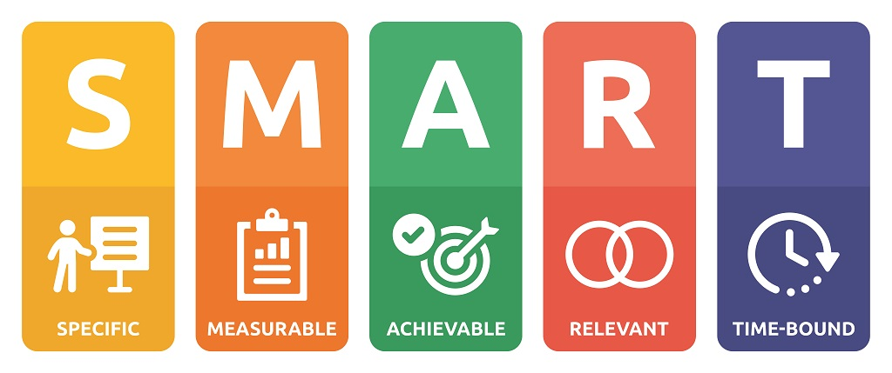
Work Backwards – Goals, Outcomes, Activities
Pick a timeline, it could be 1-year, 2-years or 5-years
Create a list of no more than four SMART goals
For each goal, name some desired outcomes
activities are the “boots on the ground” implementation of your vision

Slide 7
Listening Prayer
Create a quiet place for stillness.
Open your hearts and minds to the Still-Speaking God, invite the Spirit to be with you.
Name the worries, hopes and dreams you have for your Community of Faith.
Follow the body feelings, not just the analytical thoughts; when you pray over a particular situation or concern, how does it feel in your body?
Listen for places where multiple people have a strong feeling, ask where that feeling is coming from. Is it resistance to something new? A deep place of pain? A bubbling passion? An old narrative that needs to be challenged? A new perspective to be digested? A feeling of inspiration?
Go slow, don’t rush the Spirit. More than one time of prayer may be needed.

Slide 8
Vision Statement
A statement that describes what your ministry hopes to achieve or become in the future. It's a clear, compelling, and aspirational statement that provides a long-term direction and purpose.

